Slide 1
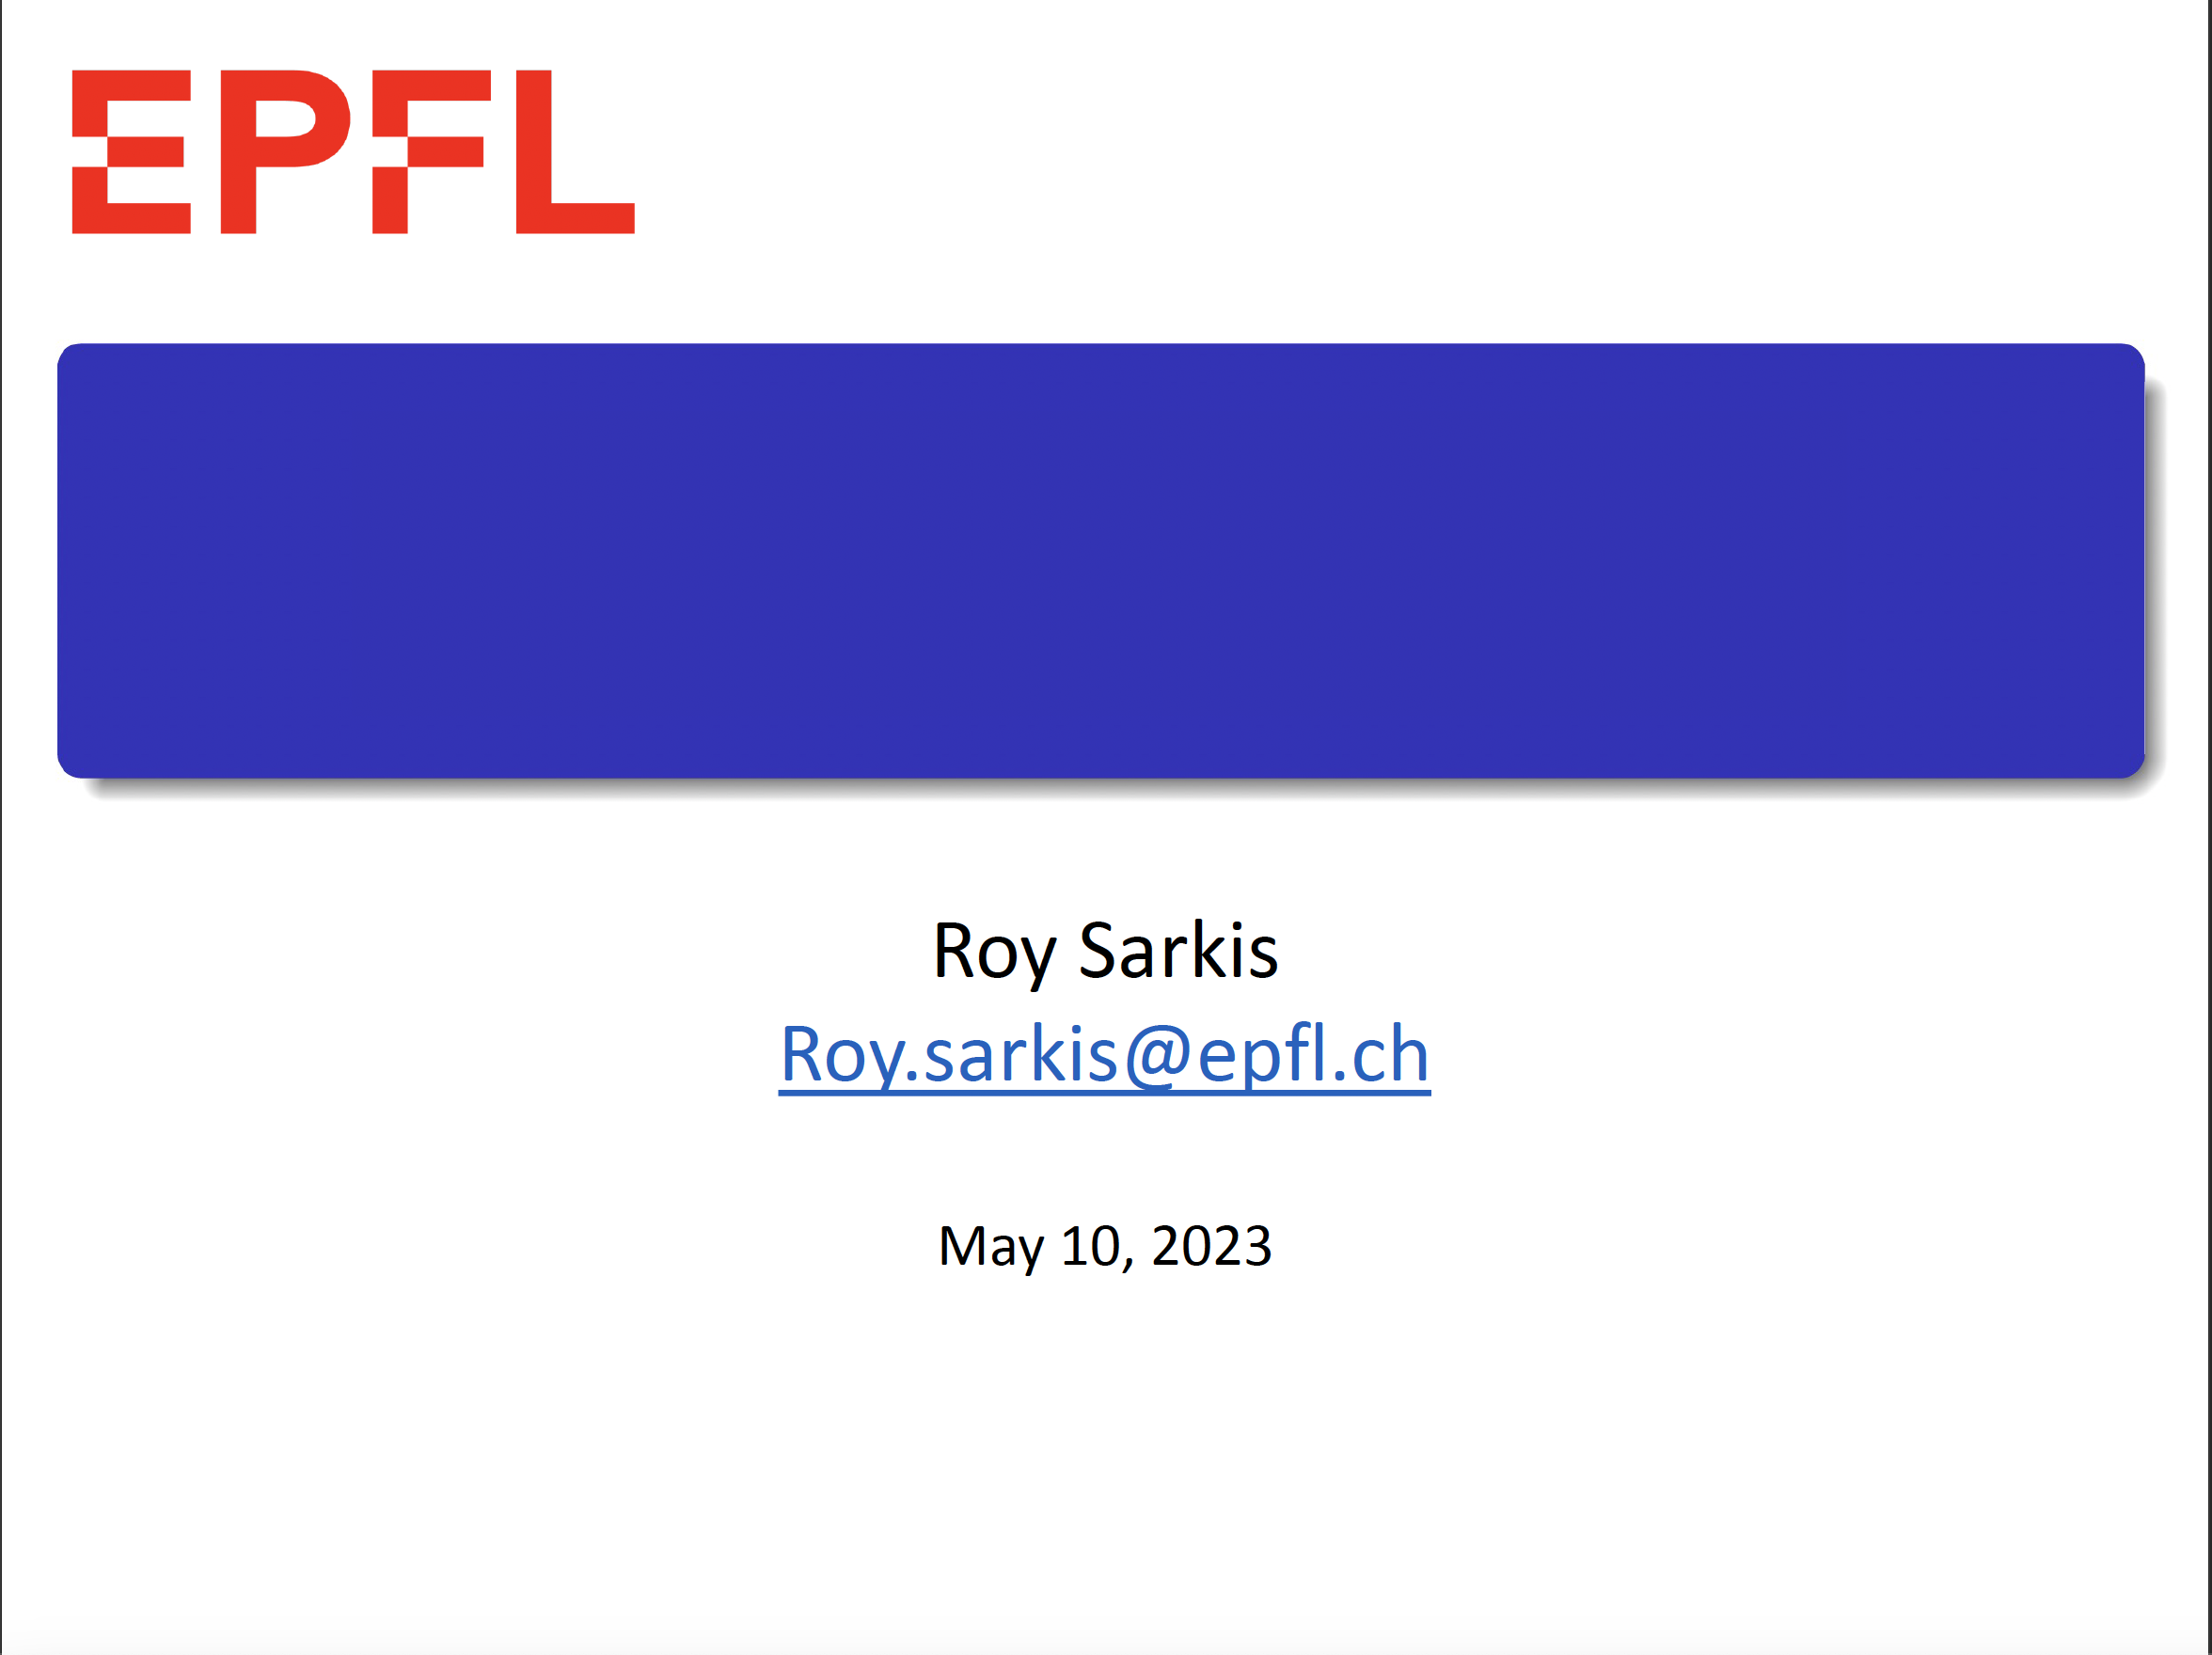
Intraday GHI Prediction Using Webcams
Roy Sarkis
roy.sarkis@epfl.ch
May 2024

Slide 2
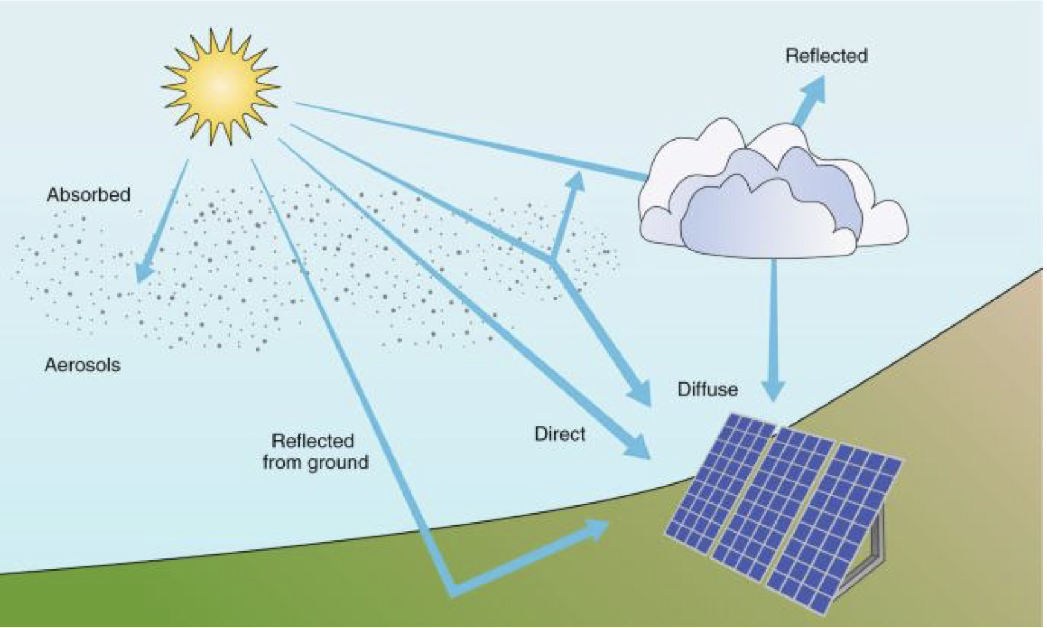
Global Horizontal Irradiance (GHI)
GHI is the total solar radiation incident on a horizontal surface

Slide 3
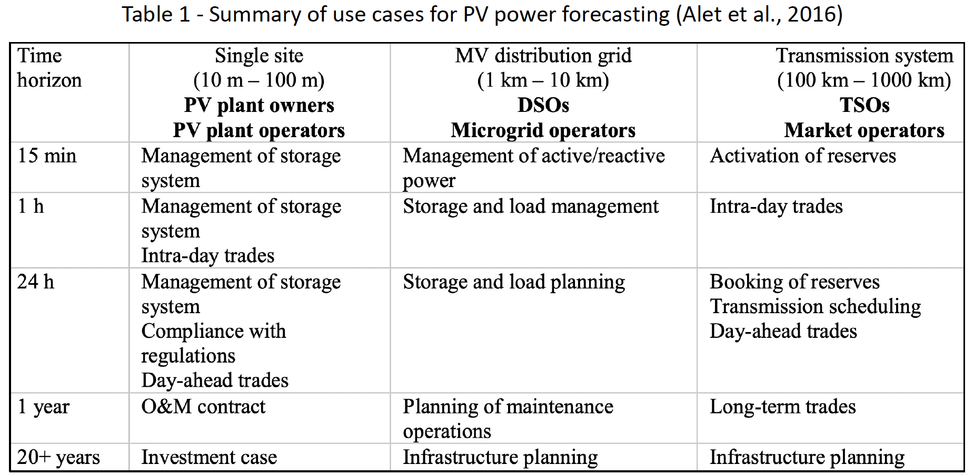
Importance of GHI Prediction
Photo-voltaic (PV) generation is experiencing significant growth thanks to the decreasing costs of installations and reduced carbon footprint.
However, the progressive displacement of conventional power generation in favor of renewables like PV, requires having an adequate capacity of regulating power to ensure reliable operation and grid stability.
This relies on the availability of high-performance solar irradiance forecasting tools at day-ahead and intraday time horizons.

Slide 4
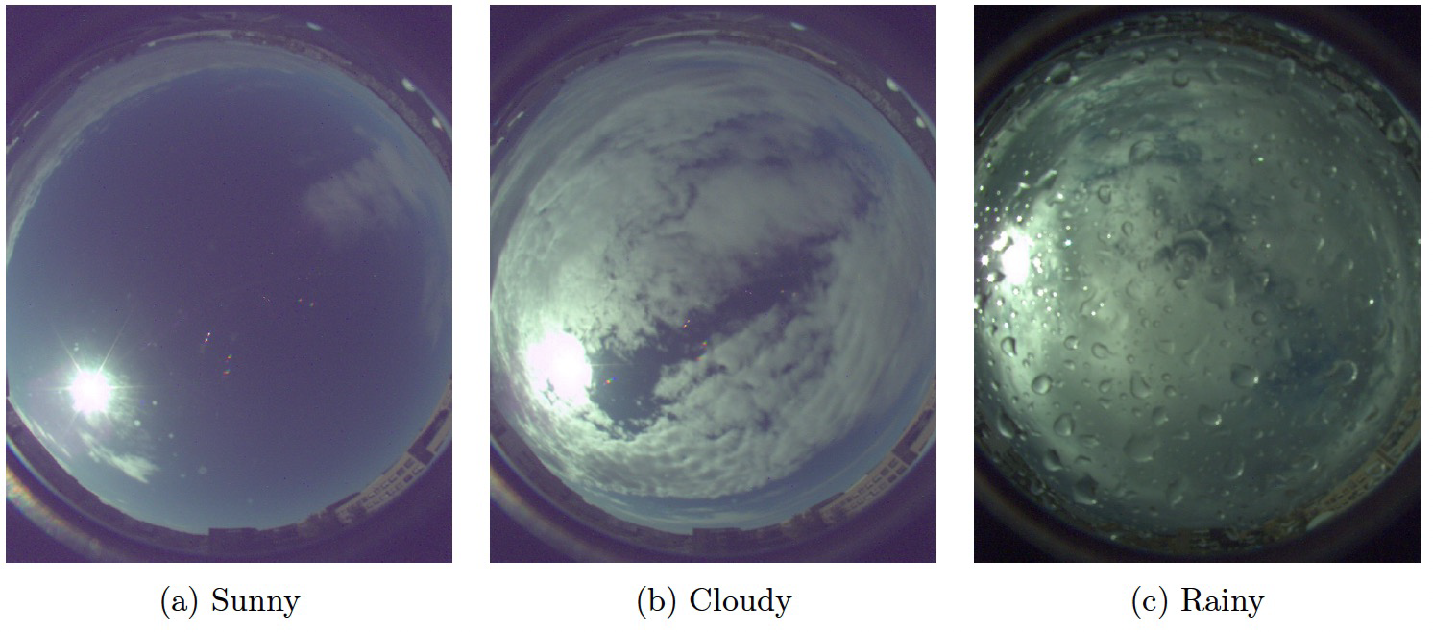
GHI Prediction
GHI could be predicted via:
Time series of historical GHI (could also include meteorological data)
Feature extraction from all-sky images images with neural networks
However, time series models are not suitable for GHI predictions in the 1 – 6 hour range.
Problem with all-sky cameras?

Slide 5
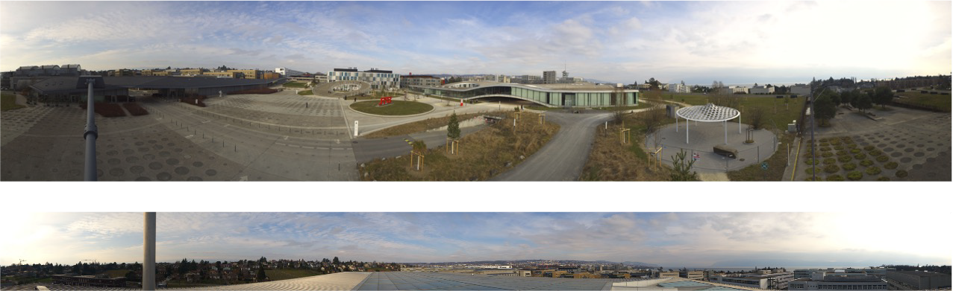
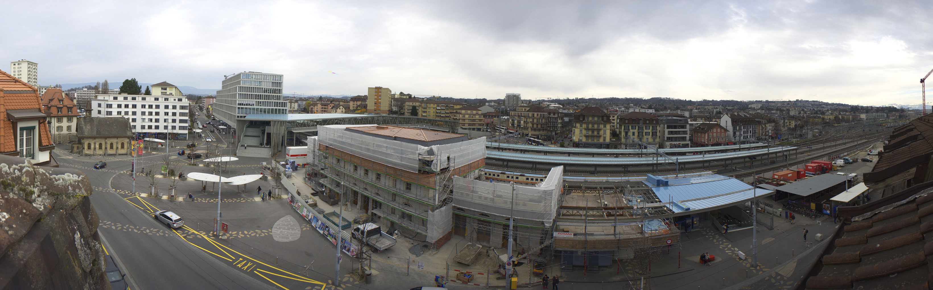
Our Approach
Use images from public webcams

Slide 6
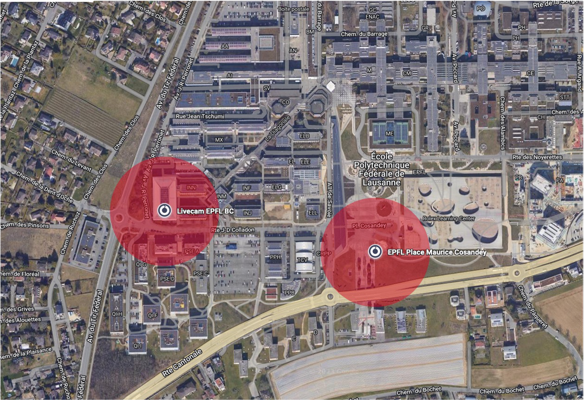
Data Description
X_M_train.npy and X_BC_train.npy: two sets of 13800 RGB images (250x250x3) collected from two different cameras located on campus. The images are panoramic 360°.

Slide 7
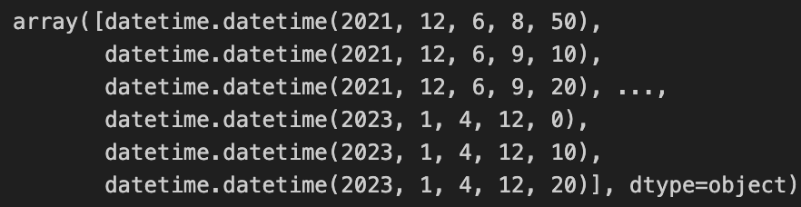
Data Description
X_M_train.npy and X_BC_train.npy: two sets of 13800 RGB images (250x250x3) collected from two different cameras located on campus. The images are panoramic 360°.
common_time_train.npy: time of the collected training images. So, the first element of the array common_time_train.npy corresponds to when the first image of X_M_train and of X_BC_train were collected.

Slide 8
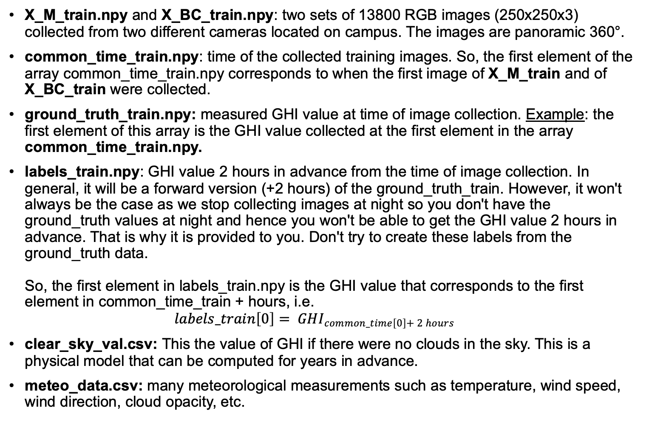
Data Description
X_M_train.npy and X_BC_train.npy: two sets of 13800 RGB images (250x250x3) collected from two different cameras located on campus. The images are panoramic 360°.
common_time_train.npy: time of the collected training images. So, the first element of the array common_time_train.npy corresponds to when the first image of X_M_train and of X_BC_train were collected.
ground_truth_train.npy: measured GHI value at time of image collection. Example: the first element of this array is the GHI value collected at the first element in the array common_time_train.npy.
labels_train.npy: GHI value 2 hours in advance from the time of image collection. In general, it will be a forward version (+2 hours) of the ground_truth_train. However, it won't always be the case as we stop collecting images at night so you don't have the ground_truth values at night and hence you won't be able to get the GHI value 2 hours in advance. That is why it is provided to you. Don't try to create these labels from the ground_truth data. So, the first element in labels_train.npy is the GHI value that corresponds to the first element in common_time_train + hours, i.e. $labels_train\left[0\right]= GHI_{common_time\left[0\right]+ 2 hours}$
clear_sky_val.csv: This the value of GHI if there were no clouds in the sky. This is a physical model that can be computed for years in advance.
meteo_data.csv: many meteorological measurements such as temperature, wind speed, wind direction, cloud opacity, etc.

Slide 9
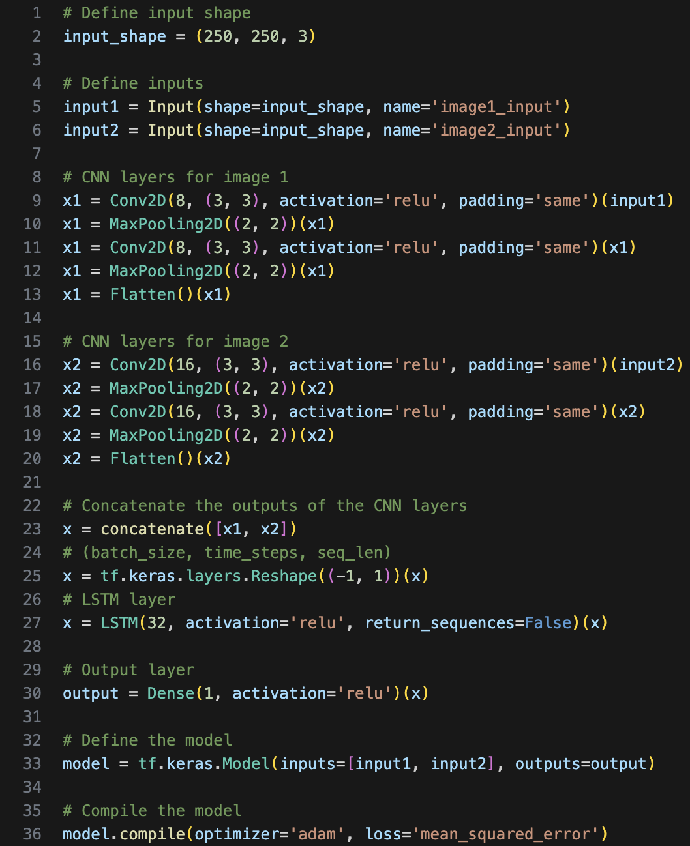
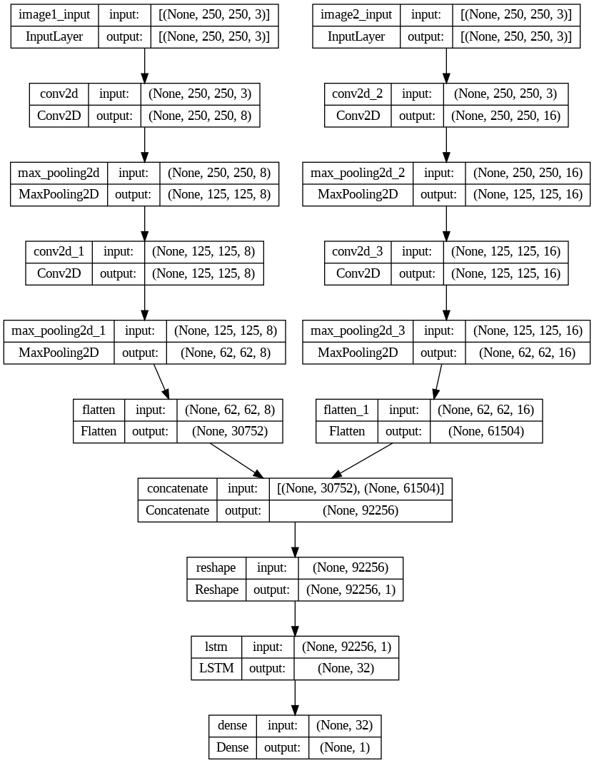
Network Architecture
We asked Chat GPT: “We want a neural network in python that has CNN and LSTM layers to predict solar irradiance from an input of 2 RGB images”.

Slide 10
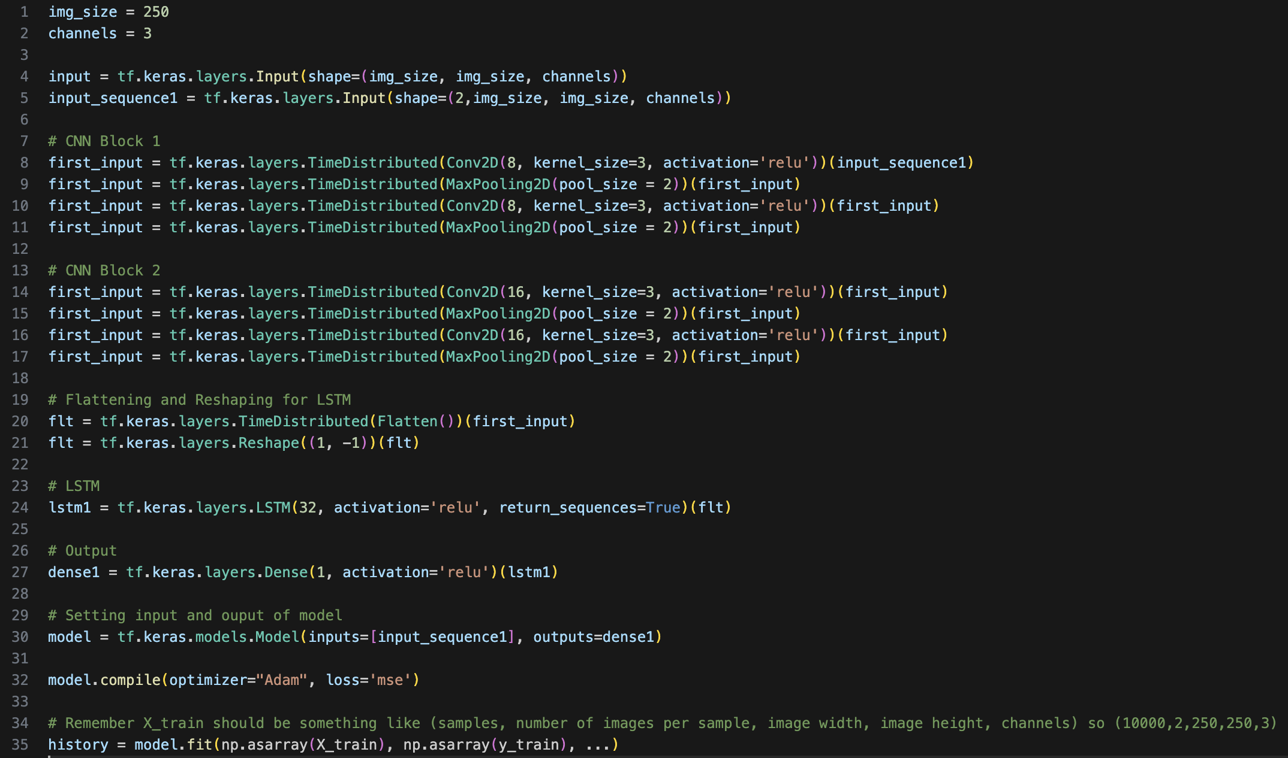
Network Architecture – Time Distributed
Modified with Time Distributed
Modify your input to have one X with shape (10000, 2, 250, 250, 3). You can use X = np.stack((X1,X2), 1)

Slide 11
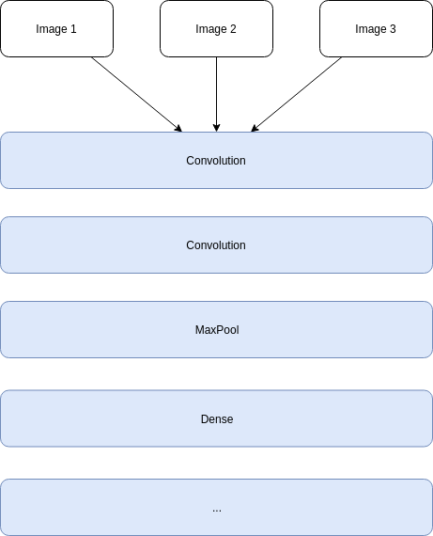
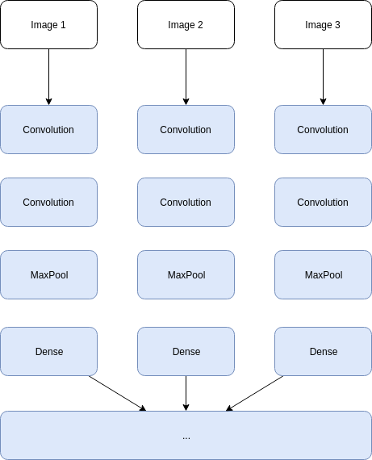
Network Architecture – Time Distributed
Requires long training as we need to train several convolution flows (one per input image)

Slide 12
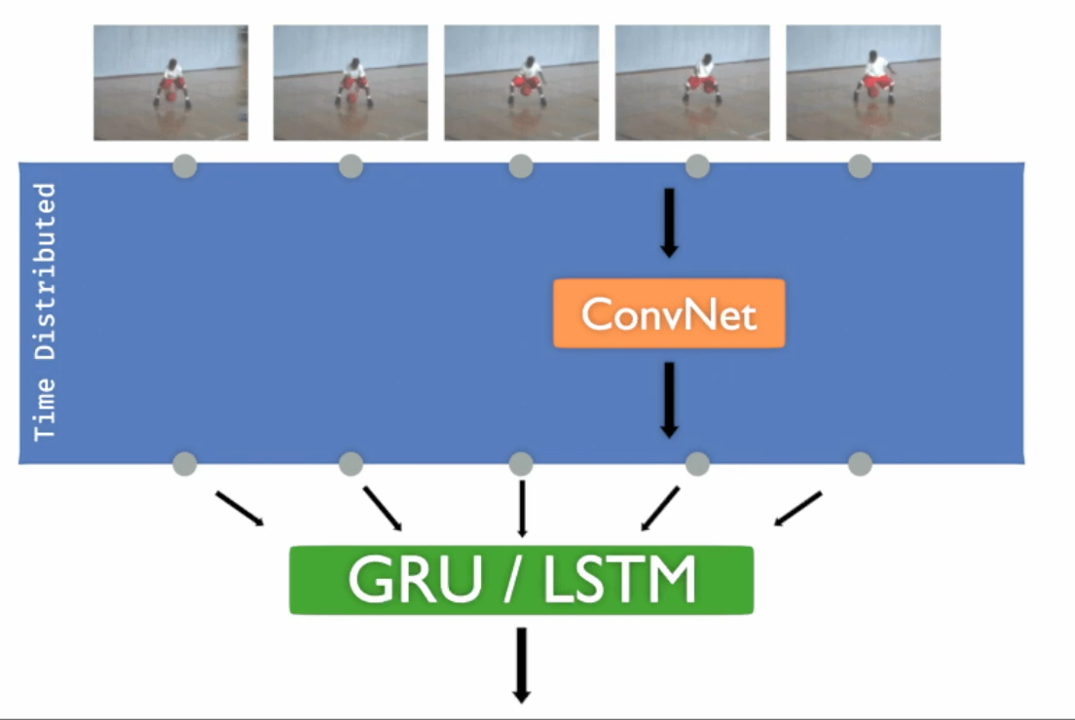
Network Architecture – Time Distributed
The Time Distributed Layer applies the same instance of the layer to each image.
So we don’t have different sets of weights for this layer.
The same set of weights are applied to all images.
By using this layer, we will not be increasing the complexity of the model. Yet, the model has the ability to learn from different images separately with just one layer.

